Slide 1

PHOTO ALBUM
Riyadh
Deion
Topgyal
Wei

Slide 2

DESCRIPTION- Photo album Website
lets user make photo albums.
User needs provide username, password, email.
Can upload photos and put them into photo album.
Database to store user information, photo albums and photos

Slide 3
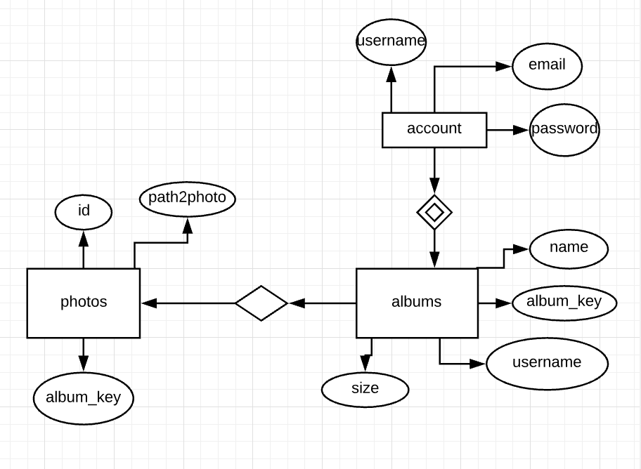
E-R DIAGRAM

Slide 4
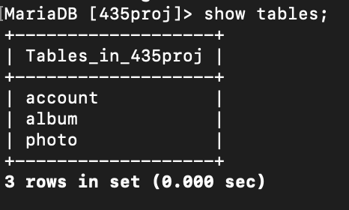
Database: 435proj

Slide 5
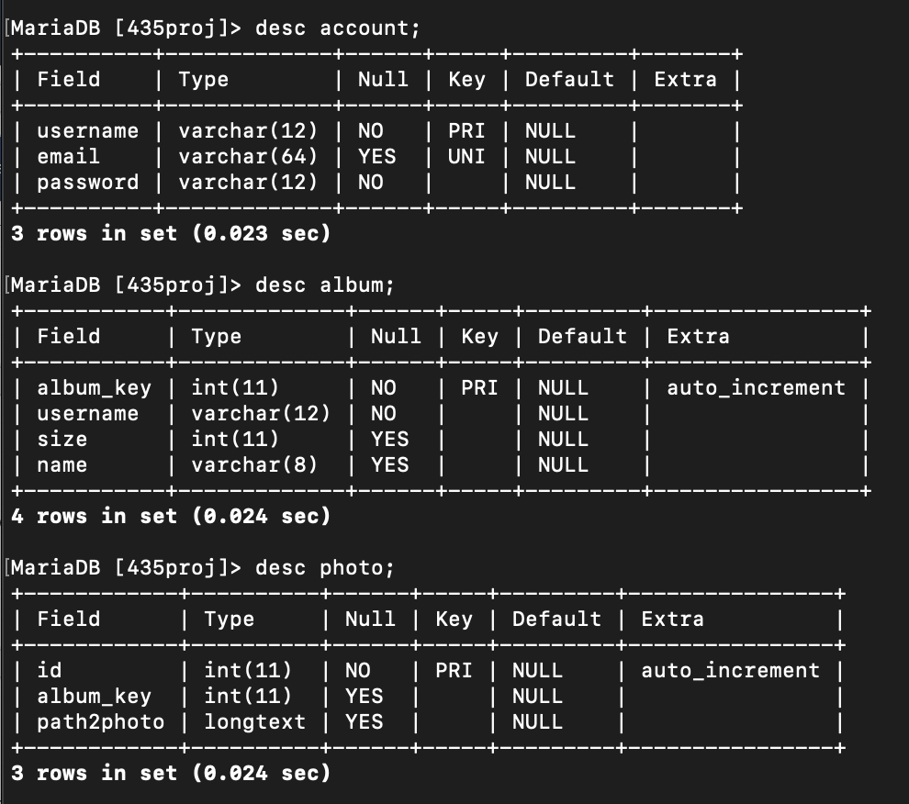
Tables and their entities

Slide 6
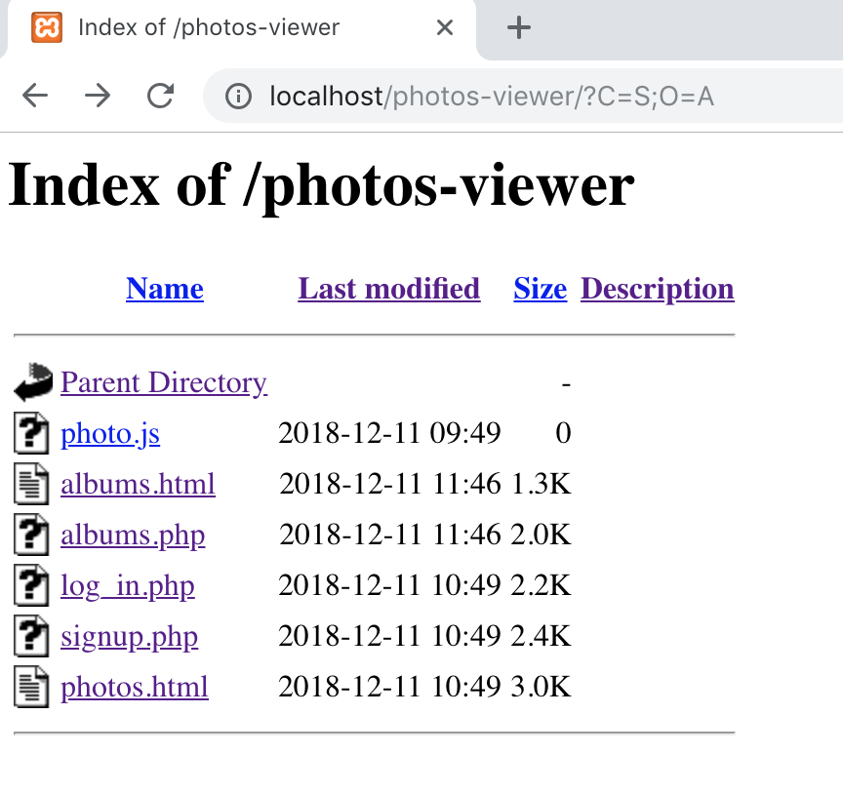
Indexes

Slide 7
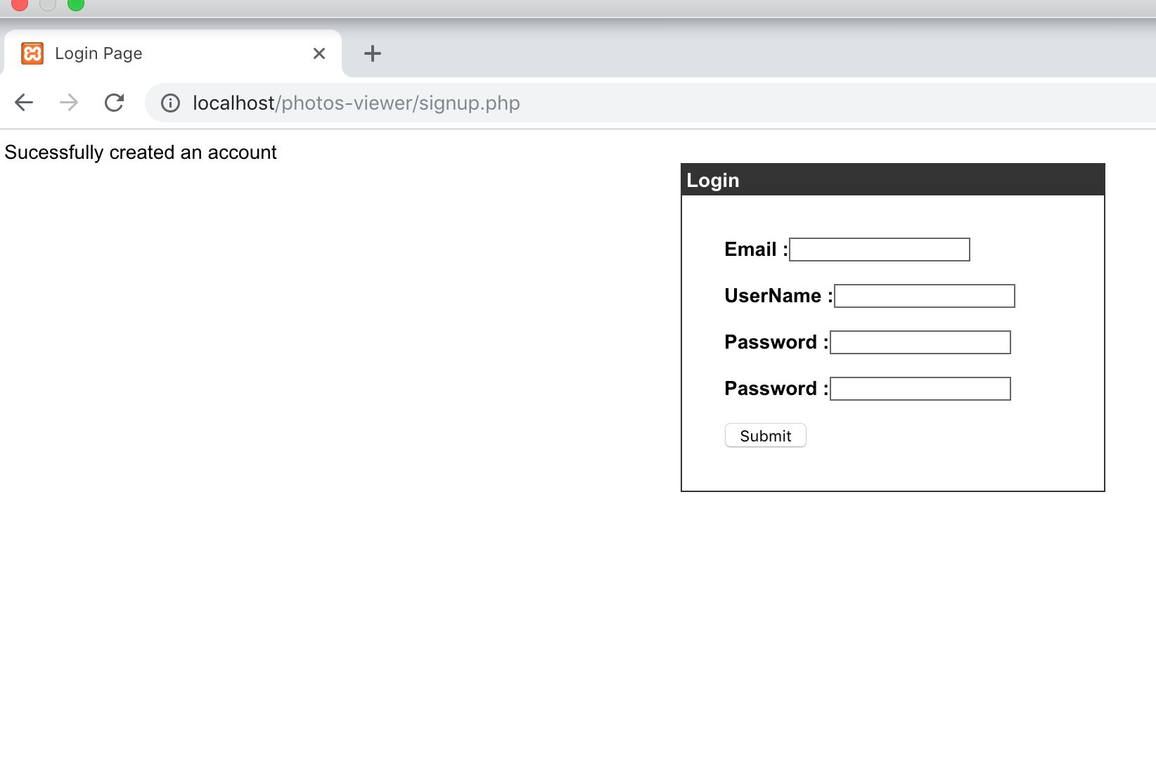
Account – Sign up and Login

Slide 8
Albums

Slide 9
Photos
store images in a database converting the image to base64 data before storing the data
Path2 photo Data type: long text to store base64 data

